Slide 1
Data Security & Integrity
Authentication and authorization

Slide 2
Integrity
Data Integrity – Primarily concerned with the accidental damage and recovery of data.
System Integrity – Ensures there is no way for any unauthorized program to:
Bypass security checking
Obtain control in an authorized state
Bypass store or fetch protection

Slide 3
Security
The concept of security within the network environment includes all aspects of operating systems, software packages, hardware, and networking configurations, as well as any network sharing connectivity.
Other scopes of security are also considered for example; Physical Security, Security Camera IP addresses and Storage Space.
Disaster recovery plans must now cover the entire business entity, and physical access to unauthorized areas can be disastrous for a company.
Notes:
We cover the basics of properly securing your network, which includes learning about threats and vulnerabilities, encryption, firewalls and best practices.
Computer security is designed to protect your computer and everything associated with it --- the building, the workstations and printers, cabling, and disks and other storage media. Most importantly, computer security protects the information stored in your system.
Computer security is not only designed to protect against outside intruders who break into systems, but also dangers arising from sharing a password with a friend, failing to back up a disk, spilling a soda on a keyboard. There are three distinct aspects of security: secrecy, accuracy, and availability.

Slide 4
Fundamentals of Secure Networks
Internal security and external security

Slide 5
Fundamentals of Secure Networks
The modern computer world is a complex mix of different components with the purpose of making resources available to those who need them.
Unfortunately, access to networks by unauthorized users has grown at a rate that far outpaces anything we could have imagined.
More and better computing devices are made but technology for securing them has grown at a much slow pace.
This puts computer networks and resources at risk. (hackers, curious minds, disgruntled employees)
Security is not just a policy or a plan, it is a mindset.
You must properly train and cultivate employees to be security aware.
Notes:
You can never finish the project of securing a network and you can’t ever be
completely certain that a network is secure. How much money you invest in securing a
network, how much time you devote to the job, or how much fancy security hardware and

Slide 6
Fundamentals of Secure Networks
You can never finish the project of securing a network and you can’t ever be completely certain that a network is secure.
Note that No network is ever completely secure. Or The only secure network is the one nobody can use!
Good network security helps prevent all the following:
Company secrets, such as proprietary designs or processes, from falling into the wrong hands (both internally and externally)
Personal information about employees from falling into the wrong hands
Loss of important information and software
Loss of use of the network itself
Corruption or inappropriate modification of important data
Notes:
Most things you will learn about networking are relatively straightforward and can be
accomplished. Do you want a new file and print server? You install it and set it up, and it
either works or it doesn’t. If it doesn’t work, you proceed to troubleshoot it, fix any issues,
and ultimately you complete the task. Network security, on the other hand, is a horse of a
different color. You can never finish the project of securing a network and you can’t ever be
completely certain that a network is secure. How much money you invest in securing a
network, how much time you devote to the job, or how much fancy security hardware and
software you install doesn’t matter: No network is ever completely secure. (Hilariously,
there’s a corollary to this: The only secure network is the one nobody can use.)

Slide 7
Basic network security practices
Stay current on threats and available patches to be sure that the servers and workstations are properly secured.
Learning to implement encryption on sensitive data. only the things you need to keep confidential because encryption can add some overhead to your network. (low speeds)
Disaster recovery and incidence response plans need to be tested and updated on a regular basis. It all starts with proper planning.
Remember that your network is only as strong as its weakest link, which is usually a human being, a concept that we will discuss further in the “Social Engineering” section later
Setup a Security Policy for the network. (password change, blocking etc.)
Notes:
The first thing you
need to do is know what you intend to do and why. Know what you're going to secure and
how you're going to secure it, what you're going to block and allow and in order to do this,
Remember, the security
policies pretty much dictate what goes on in a network and why. That way you'll know what
you need to do to implement those policies.

Slide 8
Basic network security practices
Layer your defenses. Don't rely on one box alone to protect your network. Put some filtering rules on your border devices, such as your border router and put some other filtering rules on your firewalls.
Think about load balancing. If your router has all the rules on it and it gets destroyed by a hacker, everyone will able to use your network
Use network security zones to protect both your published servers and internal networks. Published servers are basically servers that you want to allow Internet users outside your network to be able to access.
Use those devices and those architectures that offer a benefit. If there's no benefit to it for you, then don't use it just because it's the latest and greatest thing out there.

Slide 9
Internal Security
Internal security is the process of securing your network from internal threats Examples of internal threats include:
Internal users inappropriately accessing information to which they should not have access, such as payroll records, accounting records, or software development information
Internal users accessing other users’ files to which they should not have access
Internal users impersonating other users and causing mischief, such as sending e-mails under another person’s name
Internal users accessing systems to carry out criminal activities, such as embezzling funds
Internal users compromising the security of the network, such as by accidentally (or deliberately) introducing viruses to the network
Internal users “sniffing” packets on the network to discover user accounts and passwords
Notes:
To managing security, you need to expect the worst of people and then you must take steps to prevent those actions you expect.

Slide 10
Account Security (providing internal security)
Account security refers to the process of managing the user accounts enabled on the network.
A number of tasks are required to manage user accounts properly, and the accounts should be periodically audited (preferably by a different person than the one who manages them daily) to ensure that no holes exist.
Most NOSs start up with a user account called “Guest.” You should remove this account immediately because it is the frequent target of crackers.
Most NOSs start up with a default name for the administrative account. Rename this account to avoid directed attacks against the account
know the steps required to remove access to network resources from any account and be sure to explore all network resources that might contain their own security systems
Work closely with the Human Resources department to handle security issues related to employee departures
Notes:
TIP: As a safety measure, also create a new account to be a backup of your administrative
account. Call it whatever you like (although less obvious names are better), give the account
security equivalence to the administrative account, and safely store the password. Should
something happen that locks you out of the real administrative account, you can use the
backup account to regain access and correct the problem.

Slide 11
Account Security (providing internal security)
Setup policy whereby new users on the network have their assigned permissions reviewed and signed off by their supervisor.
Account password security policy. (enable this for NOS) You should cause users to change their main network password every 90 to 180 days (30 days is a common recommendation, but this may be too frequent in most environments).
Set the reuse policy so that passwords cannot be reused for at least a year.
Intruder detection. Make sure that you turn on any policies that monitor for and deal with people entering in wrong passwords.
Establish limits on when and where certain users can log on to the network if NOS has this feature. (Novell NetWare and Windows NT)

Slide 12
File and Directory Permissions (providing internal security)
Establish regular procedures, then follow them and then periodically spot-audit parts of the directory tree, particularly areas that contain sensitive files
Also, structure the overall network directories so that you can, for the most part, simply assign permissions at the top levels. These permissions will “flow down” to subdirectories automatically, which makes it much easier to review who has access to which directories.
NOSs allow considerable flexibility in the permissions on files and directories. Using the built-in permissions, you can enable users for different roles in any given directory.
These roles control what the user can and cannot do within that directory.
Examples of generic directory roles include the following:
Create only
Read only
Change
Full control
Just as you can set permissions for directories, you can also set security for specific files.
Notes:
Create only This type of role enables users to add a new file to a directory, but restricts
them from seeing, editing, or deleting existing files, including any they’ve created.
This type of role is perfect to enable a person to add new information to a directory
to which they shouldn’t otherwise have access. The directory becomes almost like a
mailbox on a street corner: You can put only new things in it. Of course, another user
will have full access to the directory to retrieve and work with the files.
Read only This role enables users to see the files in a directory and even to pull up the
files for viewing on their computer. However, the users cannot edit or change the
stored files in any way. This type of role is good for material published to users who
need to view the information, but which they should not change. (Users with read
privileges can copy a file from a read-only directory to another directory and then do
whatever they like with the copy they made. They simply cannot change the copy
stored in the read-only directory itself.)
Change This role lets users do whatever they like with the files in a directory, except
they cannot give other users access to the directory.
Full control Usually reserved for the “owner” of a directory, this role enables the
owner(s) to do whatever they like with the files in a directory and, further, enables
them to grant other users access to the directory. These roles are created in different
ways on different NOSs.

Slide 13
Practices and User Education (providing internal security)
Another important type of internal security concerns the most insecure part of any network: the people.
It’s important to establish good security practices and habits
Document the security procedures and ensure employees follow them regularly.
Keep the overall network security design as simple as possible consistent with the needs of the company.
Some more tips are as follows:
Spell out for users what is expected of them in terms of security.
Discuss security issues with new employees as soon as they join the company and are oriented on using the network,
Periodically audit users’ security actions.
Make sure that you review the security logs of the NOS you use. Investigate and follow up on any problems reported.
Depending on the culture of the company, consider having users sign a form acknowledging their understanding of important security procedures that the company expects them to follow.

Slide 14
External Security
External security is the process of securing the network from external threats.
“No network is ever totally secure”. This is especially true when dealing with external security for a network connected to the Internet.
Three basic types of external security threats exist:
Front-door threats: These threats arise when a user from outside the company somehow finds, guesses, or cracks a user password and then logs on to the network. The perpetrator could be someone who had an association with the company at some point or could be someone totally unrelated to the company.

Slide 15
External Security basic types of external security threats
Back-door threats: These are threats where software or hardware bugs in the network’s OS and hardware enable an outsider to crack the network’s security. After accomplishing this, the outsider often finds a way to log in to the administrative account and then can do anything he or she likes.
Denial of service: These are attacks that deny service to the network. Examples include committing specific actions that are known to crash different types of servers or flooding the company’s Internet connection with useless traffic (such as a downloading a huge file during working hours).
A fourth type of external threat exists: computer viruses, Trojan horses, worms, and other malicious software from outside the company

Slide 16
External Security basic types of external security threats
Viruses: A computer virus is a program that spreads by infecting other files with a copy of itself. Files that can be infected by viruses include program files (.COM, .EXE, and .DLL) and document files for applications that support macro languages sophisticated enough to allow virus behavior (Microsoft Word and Excel are common targets of macro-based viruses).
Worms: A worm is a program that propagates by sending copies of itself to other computers, which run the worm and then send copies to other computers.
Trojan horses: A Trojan horse is a program that purports to do something interesting or useful and then performs malicious actions in the background while the user is interacting with the main program.
Logic bombs: Logic bombs are malicious pieces of programming code inserted into an otherwise normal program. They are often included by the program’s original author or by someone else who participated in developing the source code. Logic bombs can be timed to execute at a certain time, erasing key files or performing other actions.

Slide 17
Cryptography
Cryptography can be defined as the conversion of data into a scrambled code that can be translated and sent across a public or private network.
Notes:
In data and telecommunications, cryptography is necessary when communicating over any un-trusted medium, which includesjust about any network, particularly the Internet.
Cryptography comes from the Greek words for ''secret writing.'' It has a long and colorful history going back thousands of years.

Slide 18
Cryptography example
Julius Caesar was an early user of cryptography.
He sent messages to his troops in a simple but ingeneous method.
A letter in the alphabet was replaced by one say 5 positions to the right. So, an "A" would be replaced by an "E", "B" by "F" and so on.
Hence RETURN would become VJYZVS.
But as it can be seen, this cipher can be easily broken by either figuring out a pattern, by brute force or by getting ones hands on a plaintext and ciphertext combination to deduce the pattern.

Slide 19
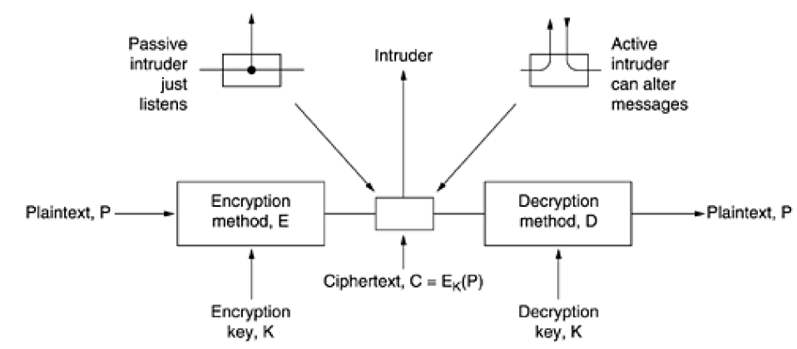
Basic encryption model

Slide 20
Basic encryption model
The messages to be encrypted, known as the plaintext, are transformed by a function that is parameterized by a key.
The output of the encryption process, known as the cipher text, is then transmitted, often by messenger or radio.
We assume that the enemy, or intruder, hears and accurately copies down the complete ciphertext. However, unlike the intended recipient, he does not know what the decryption key is and so cannot decrypt the ciphertext easily.
Sometimes we only have passive intruder (just listen to message)
Active intruders can also can also record messages, play them back later, inject their own messages, or modify legitimate messages before they get to the receiver (active intruder).
Notes:
The art of breaking ciphers, called cryptanalysis, and the art devising them (cryptography) is collectively known as cryptology.

Slide 21
Encryption
The concept behind encryption is quite simple - make the data ineligible for everyone else except those specified.
This is done using cryptography - the study of sending 'messages' in a secret form so that only those authorized to receive the 'message' be able to read it.
The two ways of going about this process are conventional (or symmetric) encryption and public key (or asymmetric) encryption.
Notes:
The basic idea of cryptography is to hide information from prying eyes. On the Internet this can be your credit card numbers, bank account information, health/social security information, or personal correspondence with someone else.
The easy part of encryption is applying a mathematical function to the plaintext and converting it to an encrypted cipher. The harder part is to ensure that the people who are supposed to decipher this message can do so with ease, yet only those authorized are able to decipher it.

Slide 22
Private Key (Symmetric) Encryption
Private Key encryption also referred to as conventional, single-key or symmetric encryption requires all parties that are communicating to share a common key. (for encrypting and decrypting)
A private encryption scheme has five major parts:
Plaintext - this is the text message to which an algorithm is applied.
Encryption Algorithm - it performs mathematical operations to conduct substitutions and transformations to the plaintext.
Secret Key - This is the input for the algorithm as the key dictates the encrypted outcome.
Cipher text - This is the encrypted or scrambled message produced by applying the algorithm to the plaintext message using the secret key.
Decryption Algorithm - This is the encryption algorithm in reverse. It uses the cipher text, and the secret key to derive the plaintext message.
Notes:
When using this form of encryption, it is essential that the sender and receiver have a way to exchange secret keys in a secure manner. If someone knows the secret key and can figure out the algorithm, communications will be insecure. There is also the need for a strong encryption algorithm. What this means is that if someone were to have a ciphertext and a corresponding plaintext message, they would be unable to determine the encryption algorithm.

Slide 23
Methods to break Private Key Encryption
There are two methods of breaking private encryption - brute force and cryptanalysis.
Brute force is just as it sounds; using a method (computer) to find all possible combinations and eventually determine the plaintext message.
Cryptanalysis is a form of attack that attacks the characteristics of the algorithm to deduce a specific plaintext or the key used. One would then be able to figure out the plaintext for all past and future messages that continue to use this compromised setup.

Slide 24
Public Key Encryption
Public key encryption algorithms are based on the premise that each sender and recipient has a private key, known only to him/her and a public key, which can be known by anyone.
Each encryption/decryption process requires at least one public key and one private key.
A public key encryption scheme has six major parts:
Plaintext - this is the text message to which an algorithm is applied.
Encryption Algorithm - it performs mathematical operations to conduct substitutions and transformations to the plaintext.
Public and Private Keys - these are a pair of keys where one is used for encryption and the other for decryption.
Ciphertext - this is the encrypted or scrambled message produced by applying the algorithm to the plaintext message using key.
Decryption Algorithm - This algorithm generates the ciphertext and the matching key to produce the plaintext.
Notes:
A key is a randomly generated set of numbers/ characters that is used to encrypt/decrypt information.

Slide 25
Encryption Algorithms
Broadly speaking, there are 3 types of cryptographic algorithms: secret key algorithms, public key algorithms, and hashing algorithms.
The third type of cryptography algorithm is called a hash or message digest function.
Unlike the preceding two types of algorithms, cryptographic hash functions typically don’t involve the use of keys. Instead, the idea is to map a potentially large message into a small fixed-length number, analogous to the way a regular hash function maps values from a large space into values from a small space.
Strong encryption is often distinguished by the key length used by the algorithm.
cryptography algorithms like DES, RSA, and MD5 are just building blocks from which a secure system can be constructed.
Notes:
Secret key algorithms are symmetric in the sense that both participants in the communication share a single key. In contrast to a pair of
participants sharing a single secret key, public key cryptography involves each participant having a private key that is shared with no one else and a public key that is published so everyone knows it. To send a secure message to this participant, you encrypt the message using the widely known public key. The participant then decrypts the message using his or her private key.

Slide 26
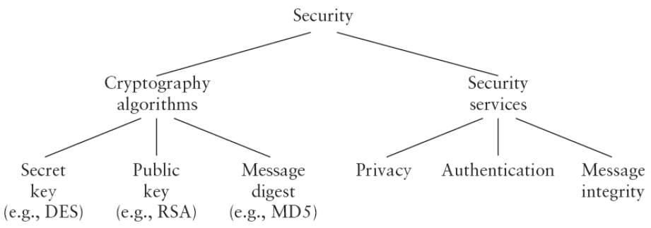
Taxonomy of network security

Slide 27
Examples of encryption algorithms
RSA: The system uses a private and a public key. RSA is the most popular method for public key encryption and digital signatures today.
DES/3DES(Data Encryption Standard): developed and endorsed by the U.S. government as an official standard and forms the basis not only for the Automatic Teller Machines (ATM) PIN authentication but a variant is also utilized in UNIX password encryption.
DES is a block cipher with 64-bit block size that uses 56-bit keys.
Triple-DES (3DES) exists as a stronger method. DES is the best-known example of a secret key encryption function.
BLOWFISH: Blowfish is a symmetric block cipher just like DES or IDEA. It takes a variable-length key, from 32 to 448 bits, making it ideal for both domestic and exportable use.
Notes:
Bruce Schneier designed Blowfish in 1993 as a fast, free alternative to the then existing encryption algorithms. Since then Blowfish has been analyzed considerably, and is gaining acceptance as a strong encryption algorithm.

Slide 28
Examples of encryption algorithms
IDEA: International Data Encryption Algorithm (IDEA) is an algorithm that was developed to replace the DES standard. It uses the same key for encryption and decryption, like DES operating on 8 bytes at a time.
Unlike DES though it uses a 128 bit key. This key length makes it impossible to break by simply trying every key, and no other means of attack is known. It is a fast algorithm, and has also been implemented in hardware chipsets, making it even faster.
SEAL: It is a Stream-Cipher, i.e., data to be encrypted is continuously encrypted. Stream Ciphers are much faster than block ciphers (Blowfish, IDEA, DES) but have a longer initialization phase during which a large set of tables is done using the Secure Hash Algorithm. SEAL uses a 160 bit key for encryption and is considered very safe.
RC4: It is a cipher with a key size of up to 2048 bits (256 bytes).
It creates a stream of random bytes and 'XORing' those bytes with the text. It is useful in situations in which a new key can be chosen for each message.

Slide 29
Authentication Protocols
Authentication is the technique by which a process verifies that its communication partner is who it is supposed to be and not an imposter.
Authentication deals with the question of whether you are actually communicating with a specific process. Authorization is concerned with what that process is permitted to do.
For example, a client process contacts a file server and says: I am Flocky's process and I want to delete the file cookbook.old. From the file server's point of view, two questions must be answered:
Is this actually Flocky's process (authentication)?
Is Flocky allowed to delete cookbook.old (authorization)?
Only after both of these questions have been unambiguously answered in the affirmative can the requested action take place.
Notes:
Verifying the identity of a remote process in the face of a malicious, active intruder is surprisingly difficult and requires complex protocols based on cryptography.
The authentication question is really the key one. Once the file server knows to whom it is talking, checking authorization is just a matter of looking up entries in local tables or databases.

Slide 30
Examples of authentication protocols
Authentication and Key Agreement (AKA)
CAVE-based_authentication
Challenge-handshake authentication protocol (CHAP)
CRAM-MD5
Diameter
Extensible Authentication Protocol (EAP)
Host Identity Protocol (HIP)
Kerberos
MS-CHAP and MS-CHAPv2 variants of CHAP
NTLM, also known as NT LAN Manager
Password-authenticated key agreement protocols
Password Authentication Protocol (PAP)
Protected Extensible Authentication Protocol (PEAP)
RADIUS
Secure Remote Password protocol (SRP)
TACACS and TACACS+
RFID-Authentication Protocols

Slide 31
Privacy
Internet privacy
The questions most often put forward are, 'Is individual privacy dead?' and 'What is the role of
technology as we slip into a society where governments and corporations seek to gain access to our information. (emails, phone calls & social media)
Notes:
George Orwell was born as Eric Arthur Blair on June 25, 1903 in Motihari, Bengal, India. He was a prolific writer with such classics as 1984 in 1949 and Animal Farm in 1945. Though the year 1984 came and passed, many of his points regarding the lack of privacy and freedoms are coming true. They might not be as blatant as in his book, but they are being passed as laws and implemented every day. It is not just governments around the world that want to gain this control, but corporations are also looking to gain profits by getting more and more information on their customers.

Slide 32
Internet Privacy issues
secure encryption on the Internet is the key to confidence for people wanting to protect their privacy, or doing business online. E-Commerce, and secure messaging are just some of the applications that rely on encryption to ensure the safety of data.
Identity theft
Social Engineering: Social Engineering is both incredibly complex and amazingly simple. Social Engineering is defined as a non-technical act of manipulating a person to accomplish goals that may or may not be in the “target’s” best interest. (can lead to giving away passwords etc.)
Packet Filtering: On the Internet, packet filtering is the process of passing or blocking packets at a network interface based on source and destination addresses, ports, or protocols. (examines the header of each packet based on a specific set of rules)
Notes:
In many companies that have proprietary or sensitive information, field personnel are required to encrypt their entire laptops fearing that in the wrong hands this information could cause a huge damage.

Slide 33
Packet Filtering
There are three ways in which a packet filter can be configured, once the set of filtering rules has been defined.
In the first method, the filter accepts only those packets that it is certain are safe, dropping all others. (most secure mode, but inconveniencing)
In the second method, the filter drops only the packets that it is certain are unsafe, accepting all others. (least secure, but less inconveniencing)
In the third method, if the filter encounters a packet for which its rules do not provide instructions, that packet can be quarantined or the user can be specifically queried concerning what should be done with it. This can be inconvenient if it causes numerous dialog boxes to appear, for example, during Web browsing.

Slide 34
Packet Filtering by Address
Restrict the flow of packets based on the source and/or destination addresses of the packets, without having to consider what protocols are involved.
It's not necessarily safe to trust source addresses because source addresses can be forged. (using Proxy apps)
There are two kinds of attacks that rely on forgery: source address and man in the middle.
In a basic source address forgery attack, an attacker sends you packets that claim to be from someone you trust in some way, hoping to get you to take some action based on that trust, without expecting to get any packets back from you. If the attacker doesn't care about getting packets back from you, he doesn't need to be on the path between you and whoever he is pretending to be; he can be anywhere.
The man in the middle forgery attack depends on being able to carry out a complete conversation while claiming to be the trusted host. In order to do this, the attacking machine needs to be able to not only send you packets, but also intercept the packets you reply with.
Notes:
In fact, your responses will go to whomever the attacker is pretending to be, not to the attacker. However, if the attacker can predict your responses, he doesn't need to see them. Many (if not most) protocols are predictable enough for a skilled attacker to be successful at this. There are plenty of attacks that can be carried out without the attacker needing to see the results directly. For example, suppose an attacker issues a command to your system that causes it to email your password file to him; if your system is going to send the attacker the password file in the mail, there is no need for him to see it during the attack itself.

Slide 35
Packet Filtering by Address
To pull off the man in the middle forgery attack, attacker needs to do one of the following:
Insinuate his attacking machine into the path between you and the real machine. This is easiest to do near the ends of the path, and most difficult to do somewhere in the middle, because given the nature of modern IP networks, the path through "the middle" can change at any second.
Alter the path between the machines so it leads through his attacking machine. This may be very easy or very difficult, depending on the network topology and routing system used by your network, the remote network, and the Internet service providers between those networks.

Slide 36
Packet Filtering by Service
Blocking incoming forged packets, as discussed previously, is just about the only common use of filtering solely by address.
Most other uses of packet filtering involve filtering by service.
For example, a service that transports all files with .flv or .rar as an extension can be filtered and all the packets containing the relevant information can be dropped.

Slide 37
Advantages of Packet Filtering
One screening router can help protect an entire network: a single, strategically placed packet filtering router can help protect an entire network.
Simple packet filtering is extremely efficient: Because simple packet filtering requires paying attention only to a few packet headers, it can be done with very low overhead.
Packet filtering is widely available: Packet filtering capabilities are available in many hardware and software routing products, both commercial and freely available over the Internet.
Notes:
If only one router connects your site to the Internet, you gain tremendous leverage on network security, regardless of the size of your site, by doing packet filtering on that router.

Slide 38
Disadvantages of Packet Filtering
Current filtering tools are not perfect: The packet filtering capabilities of most products on market, share, to a greater or lesser degree, common limitations.
Packet filtering reduces router performance: Doing packet filtering places a significant extra load on a router.
filtering is also incompatible with certain caching strategies commonly used for performance enhancement.
Some policies can't readily be enforced by normal packet filtering routers: The information that a packet filtering router has available to it doesn't allow you to specify some rules you might like to have.
For example, packets say what host they come from but generally not what user.
Notes:
This problem is eased by using more intelligent packet filters; however, in each case, you have to give up some of the advantages of normal packet filtering. For instance, a packet filter can insist that users authenticate themselves before sending packets, and then it can
filter packets by username. However, this removes the transparency advantage of normal packet filtering. A packet filter can also do protocol validity checking, but this is less than perfect and also increases filtering overhead.

Slide 39
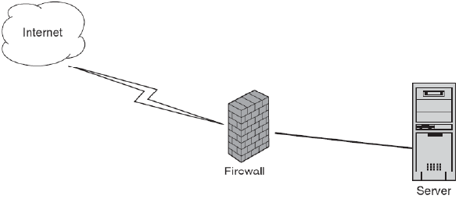
Firewalls
A firewall is a component placed between computers and networks to help eliminate undesired access by the outside world.
It can be composed of hardware, software, or a combination of both.
Firewalls make it possible to filter incoming and outgoing traffic that flows through your system.
A firewall can use one or more sets of “rules” to inspect the network packets as they come in or go out of your network connections and either allows the traffic through or blocks it.

Slide 40
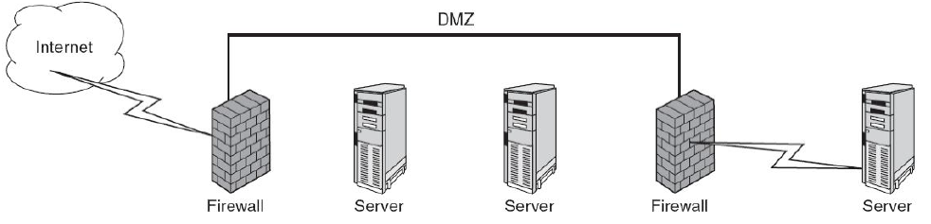
Firewalls (DMZ)
firewalls are used to implement a demilitarized zone (DMZ).
This is a network segment located between two firewalls
This is used as a buffer zone to keep the internal network safe from the outside world while offering services that are useful outside of the internal network without allowing the entire network to be available to Internet users.
Sensitive data should be located on the internal network, not the DMZ. If the DMZ is compromised, you want to be sure that the information that is stored there cannot cause harm to the company
A typical secured network with DMZ
Notes:
Many times the DMZ contains devices that need Internet
access: Web, DNS, and e-mail servers. These servers all have to be hardened to keep them
from being attacked by malicious users. Also, care should be taken when choosing what data
and services are available on these machines.

Slide 41
Filter-Based Firewalls
Filter-based firewalls are the simplest and most widely deployed type of firewall.
They are configured with a table of addresses that characterize the packets they will, and will not, forward. By addresses, we mean more than just the destination’s IP address, although this is one possibility.
Generally, each entry in the table is a 4-tuple: It gives the IP address and TCP (or UDP) port number for both the source and destination.
a firewall might be configured to filter (not forward) all packets that match the following description: (192.12.13.14, 1234, 128.7.6.5, 80) This pattern says to filter all packets from port 1234 on host 192.12.13.14 addressed to port 80 on host 128.7.6.5. (Port 80 is the well-known TCP port for HTTP.) Of course it’s often not practical to name every source host whose packets you want to filter, so the patterns can include wildcards. For example, (*, *, 128.7.6.5, 80) says to filter all packets addressed to port 80 on 128.7.6.5, regardless of what source host or port sent the packet.

Slide 42
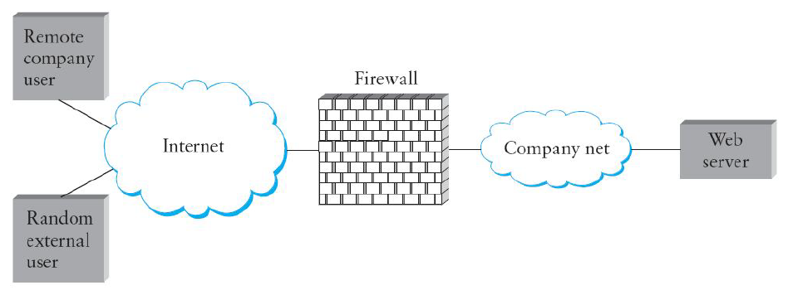
Filter-Based Firewalls
Firewall protecting a Web server from some external accesses

Slide 43
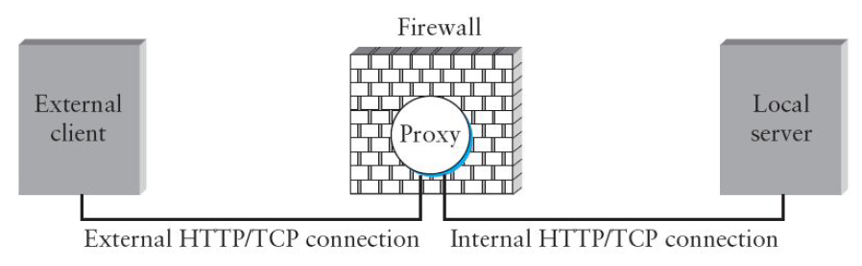
Proxy-Based Firewalls
Generally speaking, a proxy is a process that sits between a client process and a server process. To the client, the proxy appears to be the server; in a sense, the proxy is standing in for the server. To the server, the proxy appears to be the client.
One thing a proxy might do is implement a cache. This allows the proxy to respond to a client request without having to pass the request along to the server. It passes the request on to the server only if it doesn’t have the requested item in its cache.
Proxies also provide an opportunity to implement a security policy.
Notes:
Because a proxy imitates both the client and the server, it necessarily has application knowledge built into it.

Slide 44
Proxy-Based Firewalls
To understand how a proxy-based firewall works—and why you would want one—consider a corporate Web server, where the company wants to make some of the server’s pages accessible to all external users (i.e., it won’t work to simply program the firewall to block all external access to HTTP’s well-known port 80), but it wants to restrict certain of the pages to corporate users at one or more remote sites.
There is no way to express this policy as a filter since it depends on the URL contained in each HTTP request.
The solution is to put an HTTP proxy on the firewall.
Remote users establish an HTTP/TCP connection to the proxy, which looks at the URL contained in the request message. If the requested page is allowed for the source host, the proxy establishes a second HTTP/TCP connection to the server and forwards the request on to the server.
The proxy then forwards the response in the reverse direction between the two TCP connections.
Notes:
If the request is not allowed, the proxy does not create this second connection, but instead returns an error to the source. In a sense, the firewall dynamically
decides what packets to forward and what packets to drop, with the policy embodied in the application-specific proxy.

Slide 45
Proxy-Based Firewalls
Finally, proxy-based firewalls can be characterized as being either transparent or classical.
A transparent proxy, as the name implies, is not explicitly visible to either the sender or the receiver; it just happens to intercept messages that flow through it.
In contrast, the source purposely addresses messages to a classical proxy, which then forwards the message to the ultimate destination.
Consider the following example

Slide 46
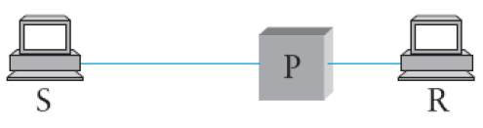
Proxy-Based Firewalls
If P is Transparent Firewall
If P is Classical Firewall
S addresses the message to R, and the message just happens to pass through P en route to R.
P either forwards the message to R, or not.
S does not know about R, but instead addresses the message to P.
In other words, P acts as an addressable front door to the site.
When the message arrives at P, it selects a node “behind it” to which it forwards the message.
source S sends a message to receiver R through proxy P

Slide 47
Transport Layer Protocol
Transport Layer Security (TLS) is a protocol that ensures privacy between communicating applications and their users on the Internet.
When a server and client communicate, sending unencrypted messages increases the risk that messages can be intercepted or altered.
TLS security technology automatically encrypts e-mail messages between servers thereby reducing the risk of snooping, interception, and alteration.
TLS is composed of two layers: the TLS Record Protocol and the TLS Handshake Protocol.
The TLS Record Protocol provides connection security with some encryption method such as the Data Encryption Standard (DES).
The TLS Handshake Protocol allows the server and client to authenticate each other and to negotiate an encryption algorithm and cryptographic keys before data is exchanged.
Notes:
TLS is an IETF (Internet Engineering Task Force) standard for communicating e-mail
securely. When TLS is enabled on the mail servers of both the sender and the receiver of the
e-mail, information exchanged between the servers is encrypted in a format that encodes
plain text into non-readable form. Mail servers use Simple Mail Transfer Protocol (SMTP) to
send and receive messages.

Slide 48
Transport Layer Protocol
When sending encrypted messages, the mail exchange works as follows:
Each company’s e-mail gateway is configured to enable TLS communications for SMTP traffic
When the sending party (client) connects to the receiving party (server), the sending party checks whether TLS services are offered
If the receiver offers TLS services, the sender initiates a TLS handshake. The server sends its TLS certificate to the client
If the sender trusts the certificate of the receiver, a TLS session encryption key is negotiated, the TLS session starts, and the SMTP message is transmitted

Slide 49
Advantages of TLS
E-mail over TLS provides the following advantages compared to traditional (unencrypted) email:
Protection. E-mail servers can be configured to enforce TLS encryption between named parties and confidential information can be exchanged with reduced risk of snooping or interception
Every e-mail sent and received is encrypted if TLS is enforced
E-mail encryption is transparent to both the sender and the receiver.
TLS is globally accepted and currently available on most, if not all, e-mail servers.
Industry Standard. There is a growing trend among financial, academic and other institutions to use TLS.
E-mail can be easily inspected for viruses. With SMTP over TLS, encryption terminates at partners’ e-mail gateways. This means that after messages move inside a company’s DMZ firewall, they can be treated just like regular SMTP traffic.
Notes:
after messages move inside
a company’s DMZ firewall, they can be treated just like regular SMTP traffic.
Messages can be inspected, scanned and analyzed for malicious content to comply
with corporate security policies. This is in sharp contrast to PGP- or S/MIME-style
encryption schemes, in which messages are decrypted only at the point of receipt.

Slide 50
Advantages of TLS
Reduced cost. When company-to-company encryption over TLS is in place, tactical person-to-person systems for encrypting messages are no longer needed. In addition, companies need only purchase TLS certificates for servers, rather than large numbers of enterprise S/MIME certificates for all clients.
No overhead for end-users. Because no special software is installed on client machines, TLS encryption is “always on” for compliant partners; the process is completely transparent to end-users.
Rapid deployment. Workstations do not require any additional configuration; only servers need to be modified. The configuration process is also straightforward. Time to value is measured in days and weeks, not months and years.

